Slide 1
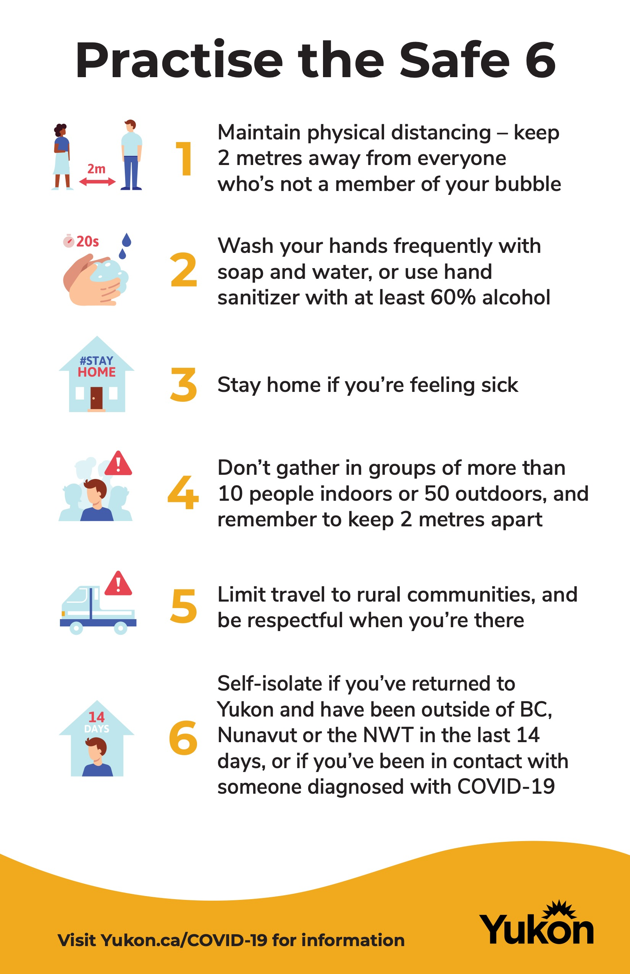

Staying Safe During COVID 19

Slide 2
Safe Distancing

Slide 3
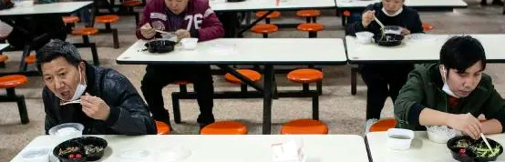
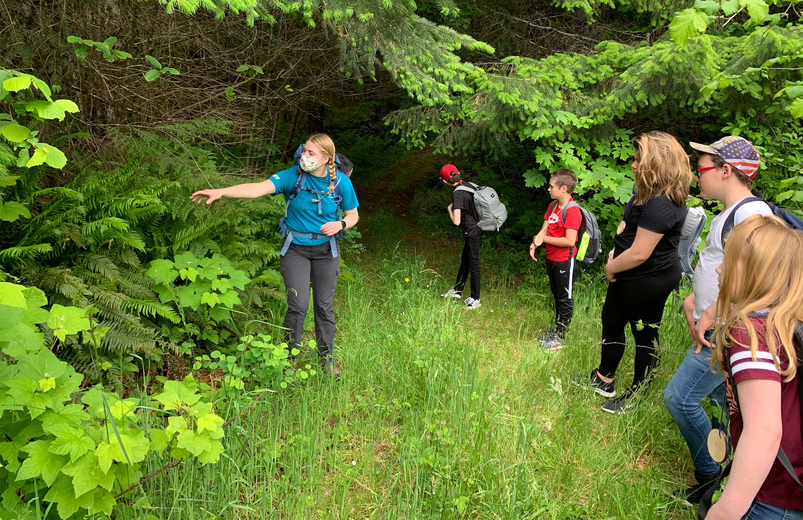
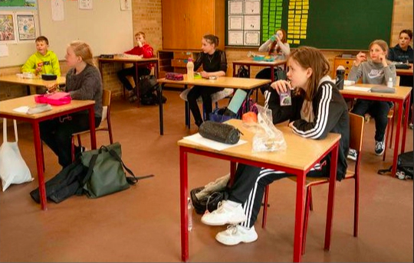
Safe distancing at School

Slide 4
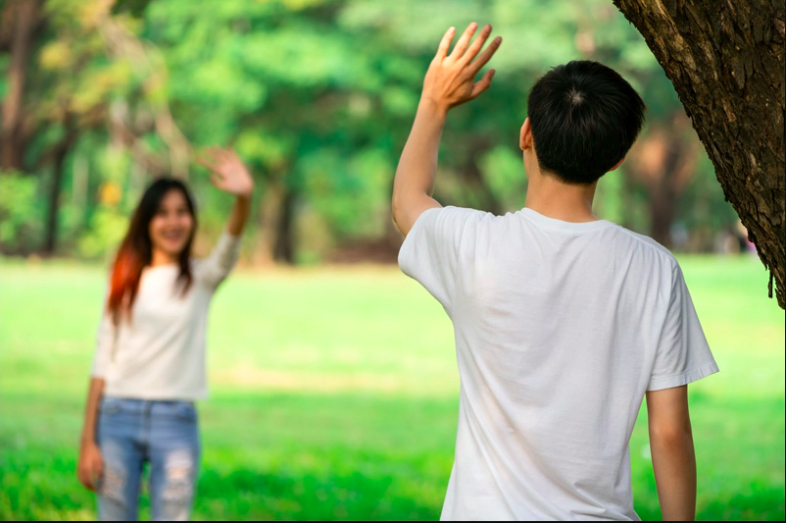
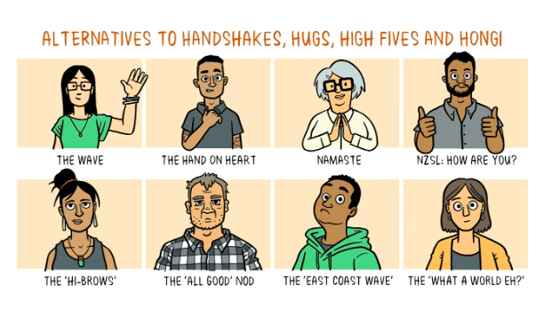
Greeting friends
Notes:
Have students practice some greetings

Slide 5
Sharing Practices
Notes:
Ask students what other items should not be shared and why

Slide 6
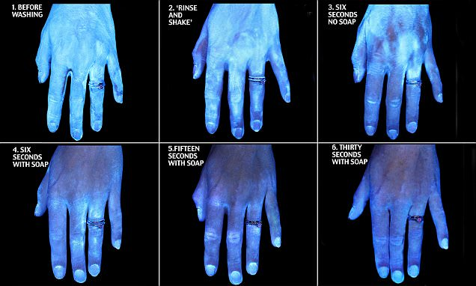
Handwashing properly and frequently
Notes:
Lots of handwashing practice can be done (see intermediate lesson for ideas)

Slide 7
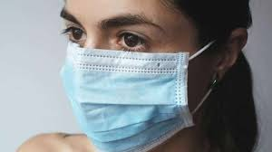
Respect Everyone’s comfort zones
Notes:
Allow opportunity for sharing comfort zones with others

Slide 8
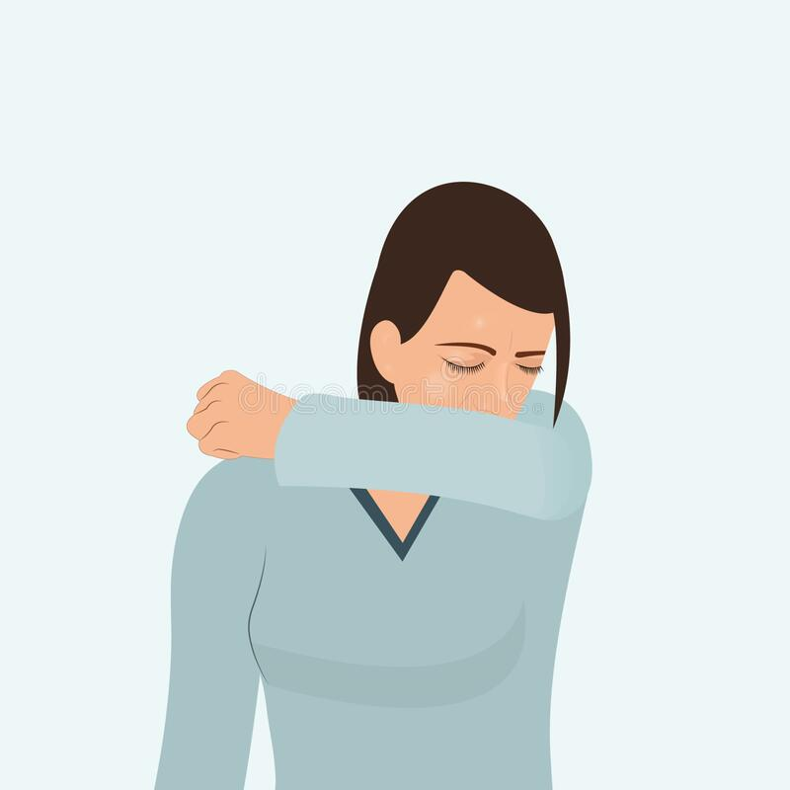
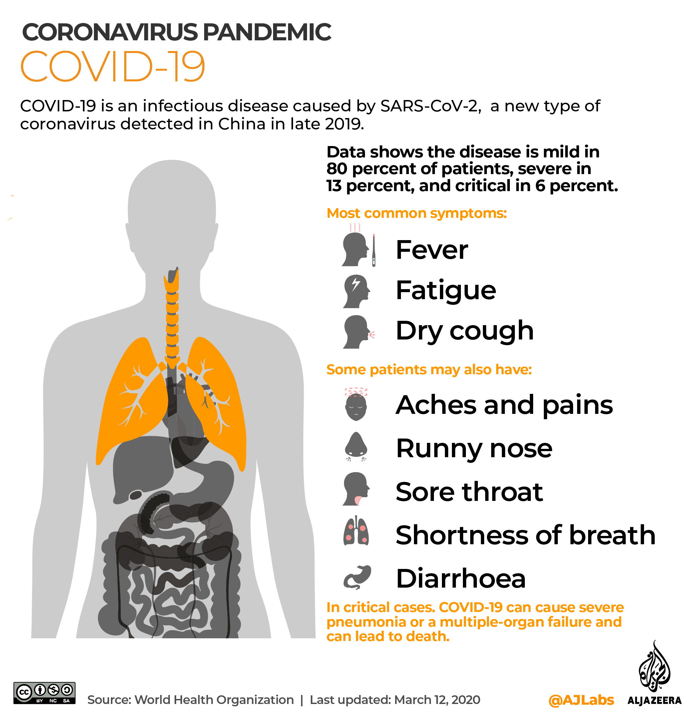
Feeling Sick?

Slide 9
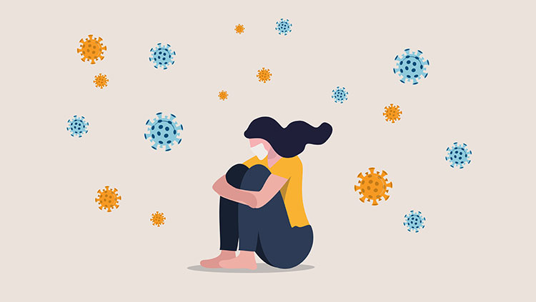
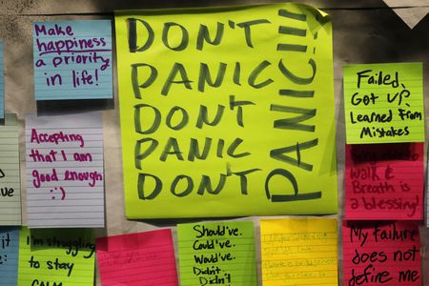
What if I am feeling sad, worried, or anxious

Slide 10
Reflection Questions
What am I doing to ensure social distancing?
How can I help friends respect social distancing?
How can I handle the peer pressure of not following safe practices such as social distancing and not sharing food or personal items?
Am I doing my part to show respect for everyone and keep everyone safe?
What can I do if I am feeling sad or anxious? Where can I find help?
Should I stay home if I just have a cold or is that overreacting?
How can I do my school work if I must stay home?

Slide 11

Questions

Slide 12
Sources
https://chinohillshowler.org/9902/editorial/the-coronavirus-a-worldwide-epidemic-or-just-the-exaggeration-of-the-common-flu/
https://www.aljazeera.com/news/2020/03/coronavirus-terminology-explained-covid-19-glossary-200323064432820.html
https://yukon.ca/en/health-and-wellness/covid-19-information/your-health-covid-19/physical-distancing-guidelines-indoors
https://www.dailymail.co.uk/health/article-3269827/How-clean-hands-answer-revealed-unique-experiment-shock-change-wash.html
https://spunout.ie/news/article/do-i-have-to-wear-a-face-mask-in-public
https://www.dreamstime.com/illustration/girl-coughing.html
https://www.cleveland.com/coronavirus/2020/06/feeling-sad-anxious-lonely-due-to-pandemic-crisis-youre-not-alone-national-surveys-say.html
https://www.brainfacts.org/diseases-and-disorders/mental-health/2020/feeling-scared-and-anxious-during-the-covid19-pandemic-is-normal-heres-why-051420

